Slide 1




(C) Parkar Consulting LLC 2017 Confidential & Proprietary

Slide 2
BLOCKCHAIN V/S FIAT CURRENCY AND INTERMEDIARY

Slide 3

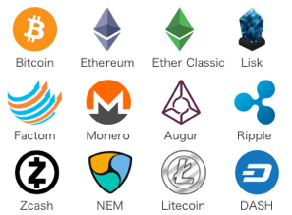
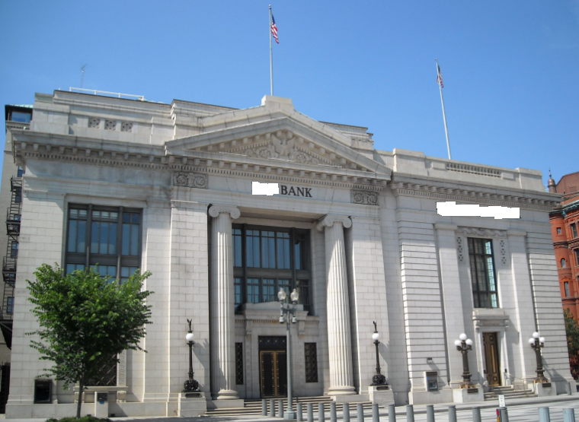
CRYPTOCURRENCY
(ESSENTIALLY BLOCKCHAIN) v/s BANK & FIAT CURRENCY
v/s
*DISCLAIMER: WE INTEND TO MEAN CRYPTOCURRENCY AS AN APPLICATION OF BLOCKCHAIN
AND BANK AS AN INTERMEDIARY

Slide 4





STORY OF TRADE, CURRENCY AND INTERMEDIARY
Notes:
In the early ages of human evolution, trade started with Barter exchange. But this system was complicated and had to be standardized.

Slide 5
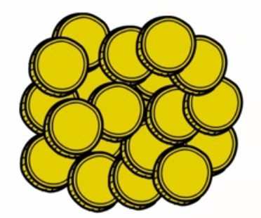
STORY OF TRADE, CURRENCY AND INTERMEDIARY
Notes:
Gold and Silver were expensive commodity even then. Hence, coins were minted out of them for trading.

Slide 6
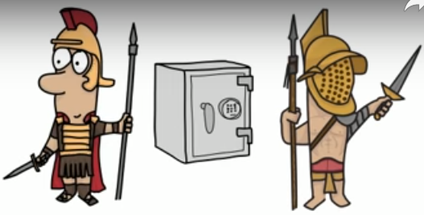

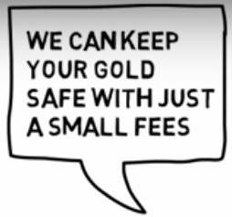
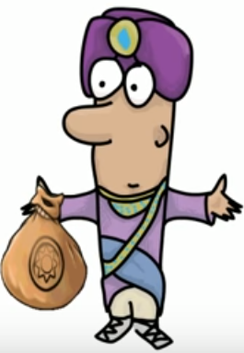
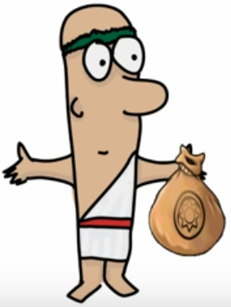

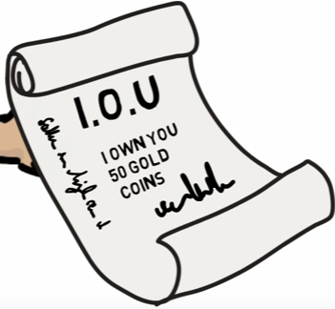
RISE OF FIAT CURRENCY
Notes:
It was difficult to keep the coins safe. That's when goldsmith offered security of the currency at a small share of the coins as security charges. Everybody liked the idea and hence people started keeping their gold with the goldsmith. In lieu of the secured gold, the goldsmith used to issue an IOU note. IOU was nothing but a paper written ... I OWN YOU 50 GOLD COINS.
You can call it a receipt. By showing this receipt the people started carrying on trade.

Slide 7
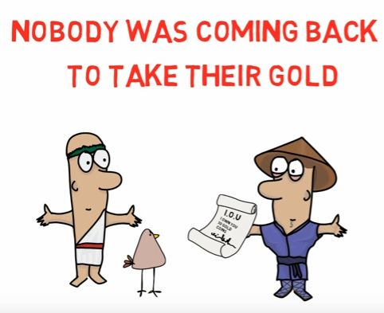
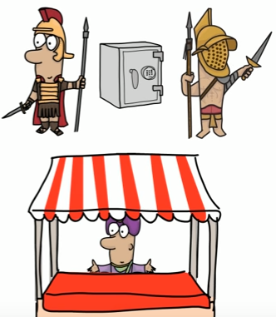
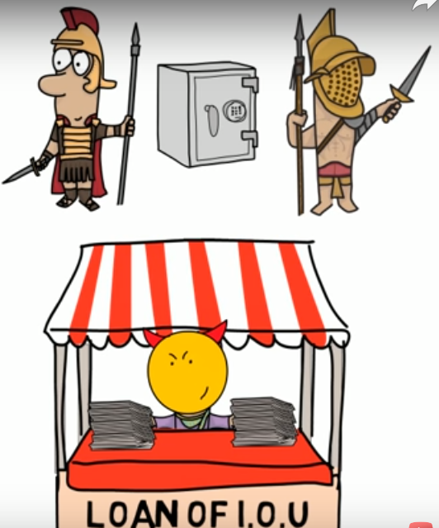


RISE OF BANK AS INTERMEDIARY
Notes:
Soon the goldsmith started realizing that after this new system of trade has started, nobody came back to claim their gold, and people started trading with the receipts itself, because everybody believed that if the trader has the receipt, then there must be definitely gold which he has secured with the goldsmith. After realizing this, the goldsmiths started getting greedy and started doing wrong deeds. Now since the IOU notes they issued had become money, they started issuing fake receipts. They never had that much of gold that they claimed to have, but they knew no one comes back to get back their gold.
Now the greed increased and they started lending the IOU to poor and needy people as a loan and started earning interest. This is how the first bank was formed and the receipt became the currency.

Slide 8
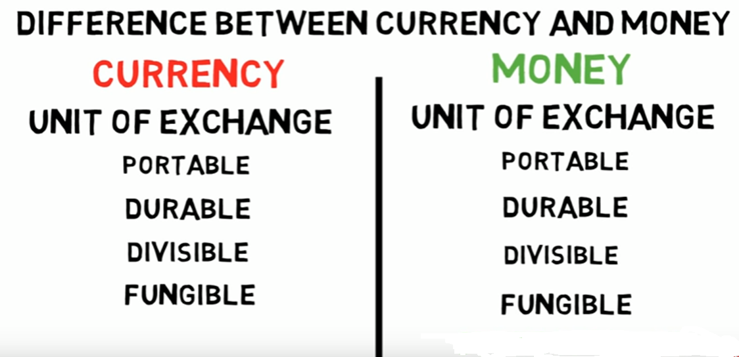
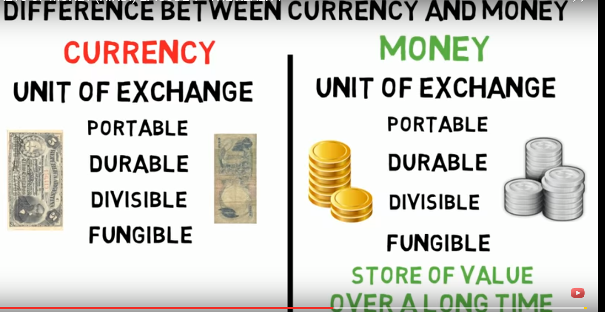
Notes:
DIFFERENCE BETWEEN CURRENCY AND MONEY
Currency and Money have many similar properties: PORTABLE, DURABLE, DIVISIBLE and FUNGIBLE
MONEY distinguishes from Currency in a way that it is a STORE OF VALUE OVER A LONG TIME
Let’s have currency-to-currency comparison to understand the difference between Fiat Currency and Cryptocurrency

Slide 9
ROUND 1: CRYPTOCURRENCY v/s FIAT CURRENCY
v/s
 | Cryptocurrency | Fiat Currency
Backed by money (asset) | No | Yes
Possibility of counterfeit | No | Yes
Form | Virtual | Physical
Creation | By mining and ICO | Backed by an asset(money)
Money like property | Just as Gold is mined, bitcoin is mined | No
WINNER: CRYPTOCURRENCY
Notes:
Backed by money (asset) No vs/ Yes
Possibility of counterfeit low v/s high
Possibility of fraud No v/s Yes
Form virtual v/s physical
Creation generated by mining v/s backed by asset (money)
Money like property Yes. Just as gold is mined, bitcoins are mined v/s No

Slide 10
ROUND 2: CRYPTOCURRENCY v/s BANK (INTERMEDIARY)
v/s
 | Cryptocurrency | Bank
International fund settlement | Seconds | Days
Account opening | Instantaneous | Days
Regulation | None | Government
IOU | No | Yes
WINNER: CRYPTOCURRENCY
Notes:
International Fund Settlement time seconds v/s days
24/7 Access Yes v/s No
Account opening instantaneous v/s days
Transaction fees lower v/s high
Regulations none v/s Government and Country
IOUs No v/s Yes

Slide 11
CORE AGENDA
Evolution of Blockchain
Real World Business Use case
Components of Business
Key concepts and components of Blockchain
Our take on Blockchain vs Centralized DB
Blockchain Business Network
What Can Blockchain do?
Types of of Blockchain network

Slide 12
EVOLUTION OF BLOCKCHAIN
REAL-WORLD USECASE

Slide 13
EVOLUTION OF BLOCKCHAIN
Year Age Gap Invention
1977 Information Age Distance Gap Internet
2009 Imagination Age Trust Gap Blockchain
DIGITAL TRUST – Fundamental currency of commerce
Enables us Transact $100 Trillion each year among 7 Billion of us
due to trusted intermediaries
MAJOR WORLD EVENTS:
7th September, 2008: Lehman Brothers filed for bankruptcy
31st October, 2008: Whitepaper published (Bitcoin: A Peer-to-Peer electronic cash system)
3rd January, 2009: First implementation of Blockchain – Bitcoin
Blockchain will fundamentally change the way we do business without intermediaries
Transition from Internet of Information -> Internet of Value
Backbone for a transaction layer for the Internet, the foundation of the Internet of Value
Notes:
We at Parkar Labs were introduced to Blockchain by Bitcoin - Also a database (nothing wrong with existing) -Necessity is mother of all inventions
DIGITAL TRUST - 100 Trillion $ - MAJOR WORLD EVENTS - Change way we do business w/o intermediaries - Transition - Backbone

Slide 14
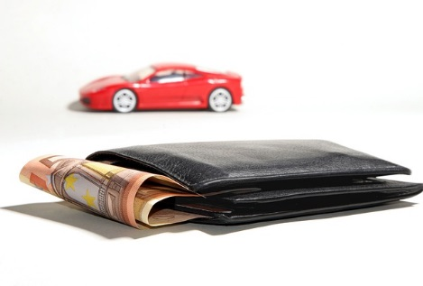

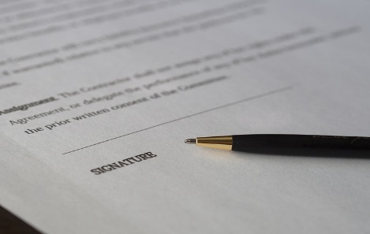

BUSINESS COMPONENTS – ASSET, LEDGER, CONTRACT & TRANSACTION
ASSET: Anything that is capable of being owned or controlled to
produce value.
- Tangible - (eg. House, Car)
- Intangible - Financial (eg. Bond) Intellectual (e.g. patents),
Digital (e.g. music)
- Cash - Has property of anonymity
LEDGER: System of record for a business. Business will have multiple
ledgers for multiple business networks in which they participate.
CONTRACT: Conditions for transaction to occur
(eg. If funds are transferred ownership is transferred)
TRANSATION: Asset transfer onto or off the ledger
(eg. transfer of ownership of car)
Notes:
Asset: Anything that is capable of being owned or controlled to produce value.
Ledger: System of record for a business. Business will have multiple ledgers for multiple business networks in which they participate.
Contract : Conditions for transaction to occur
Transaction – an asset transfer onto or off the ledger

Slide 15
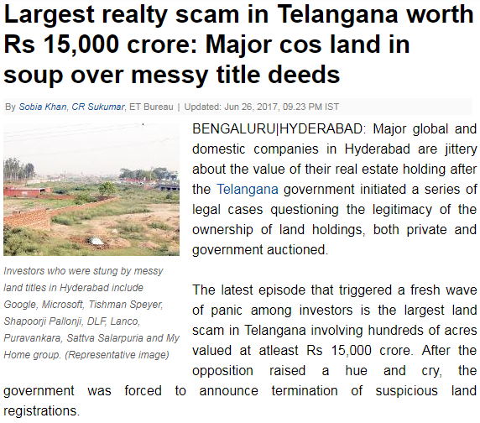
BLOCKCHAIN USECASE
Source: Economic Times - By Sobia Khan, CR Sukumar, ET Bureau|
Updated: Jun 26, 2017, 09.23 PM IST
Notes:
Lang registry scam, June this year in Miyapur village in Telangana.
Google and Microsoft, private and govt auctions.
Govt announced termination of suspicious land registrations.
Land records date back to times of Nizam, written in Persian

Slide 16
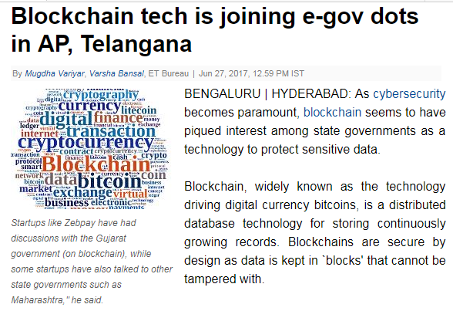
BLOCKCHAIN USECASE : POTENTIAL SOLUTION
Source: Economic Times - By Mugdha Variyar ET Bureau|
Updated: Jun 27, 2017, 12.59 PM IST
Notes:
C-DAC is joining hands with Telangana
C-DAC Director, make land records transparent, openly viewable, no chance of tampering
NEXT… I would like to welcome Amit to explain about Key concepts of Blockchain

Slide 17
KEY CONCEPTS AND
COMPONENTS OF BLOCKCHAIN

Slide 18
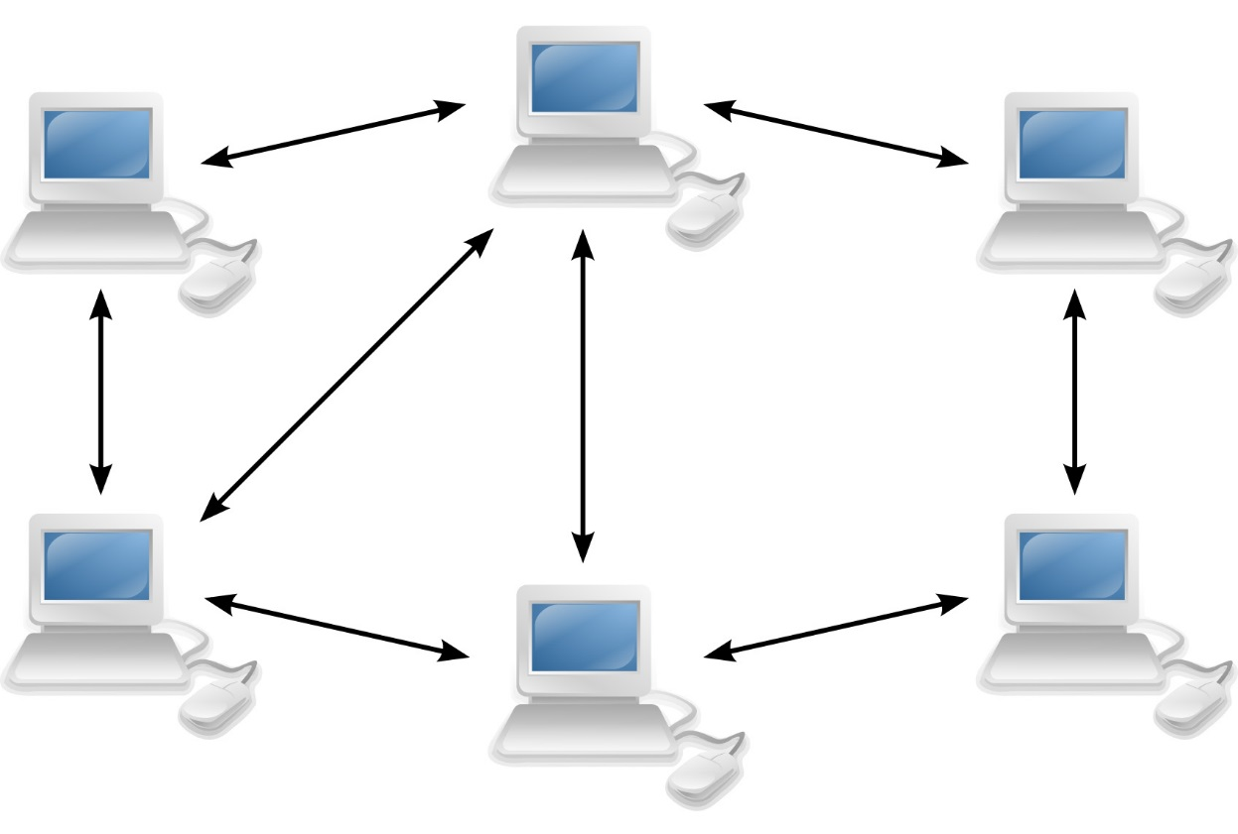
BLOCKCHAIN
Key Concepts
Cryptography
Peer to Peer Network
Ledger
Notes:
Shared Ledger
Ledger is record keeping file which store the transactions one after another. And Shared ledger is a general agreement of replicated, shared, and synchronized digital data geographically spread across multiple locations. There is no central administrator or centralised data storage. Using a peer-to-peer network ledger replication across nodes is undertaken.
Peers
They are the nodes in the peer-to-peer network, who participate in the network decisions, like broad casting the messages to other peers, approve/reject consensuses. Creating transactions passing them to Orderer, running smart contracts etc.
Miners / Orderer
They are responsible for collecting the transactions, validate them using defined endorsement policies, and rearranging them in block, creating block and broad casting these blocks to other peer nodes.
Consensus
It is general agreement between peers, how to agree upon the new transaction/ ledgers to accepted in system.

Slide 19

CRYTOGRAPHY
Symmetric Encryption
Secret Key
Hello Friend
Encryption
64DBE432A
Asymmetric Encryption
Private Key
Public Key
Decryption
Notes:
Cryptography
As you all know, cryptography means ‘hidden secret’. We are using it everywhere, it is proven technique used to share data securely between parties. This is to prevent third parties to read private content. How this works, sender encrypts content intend to send to recipient (cypher), sends over internet, and intended recipient can decrypt that cypher to extract original content. The encryption and decryption algorithm is pre decided between them.
The main purpose of cryptography is, it should be very difficult for third party to break through and extract original content and it should be trivial effort for recipient to extract original content.
So what are cryptographic algorithms, they are agreed instructions to convert simple text into cypher. It can be as simple as speaking in ‘Tamil’ (Remember how Indian Army used to communicate in Tamil in 1961 war against Pakistan.) or complex as SHA256 (image).
In digital world modern cryptography (it has very long history) now have various algorithms, it requires passwords also known as key. Based on key there are majorly two ways
Symmetric Cryptography
In this algorithm, sender and receiver shares secrete key (password) beforehand. And single key is used to encrypt and decrypt the message. It is like negation. That’s why it is symmetric. Simple real world example like, locking and unlocking the door using key. Quick example.
Asymmetric Cryptography
In this technique, two keys are used, one to encrypt and other to decrypt. There is only one combination of keys possible. This is one way. Meaning. Original message encrypted with first key can only be decrypted using second key. So what we do, we keep one key with us (private key), and share second key (public key) with everyone. Quick Example (https communication)
So let’s understand this, if you know the secrete key, it is very easy for you to do the encryption and decryption. And for outsider who don’t have the keys, it is very difficult to extract the information, and keys are kept safe, (only shared between sender and recipient). And keys are difficult to guess, or derive.

Slide 20
HASHING
Hash Codes
Digest
md5
Divide
By 100
Hash code/ Hash / Digest
Hashing techniques
High collision : Used for indexing, searching, information retrieval.
Low (or no) collision : Used in cryptography. Also known as ‘Cryptography Hash Function’
MD5, SHA256
101
1
The quick brown fox jumps over the lazy dog
9E10 7D9D 372B B682
6BD8 1D35 42A4 19D6
222
2
The quick brown fox jumps over the lazy dog.
E4D9 09C2 90D0 FB1C A068 FFAD DF22 CBD0
131
3
The quick brown fox jumps ohkr the lazy dog
86DE 9E36 B93C E716 C000 1E37 6851 B0CC
456
4
The quick bjlwn fox jumps over the lazy dog
5777 AEB4 3AF4 2C35 5521 389A 48E4 DA5F
390
5
Notes:
What is Hash/Salt
In simple terms hash or salt is fixed length (generally reduced) value derived from arbitrary size of content, using predefined set of instructions/technique. There are not keys involved in hashing. For same content there will always be same hash. For Quick example
How it is different from Encryption
We can never recover original content using hash, as opposed of encrypted cypher.
Hashing techniques
High collision: Used for indexing, searching, information retrieval.
This is out of scope of this discussion lets quickly wrap this up. Here hashing function is chosen so that, set of records in the list will return same hash value. For example: Creating Buckets, Even-odd, divide by 100.
Low collision: Used in cryptography.
This is special case hashing where collision is almost impossible. Using this hashing technique is used to get digest of a content, where same hash will be created for same content. Small change in the content will result in different hash value. It should be almost infeasible to find two different contents with the same hash value.

Slide 21
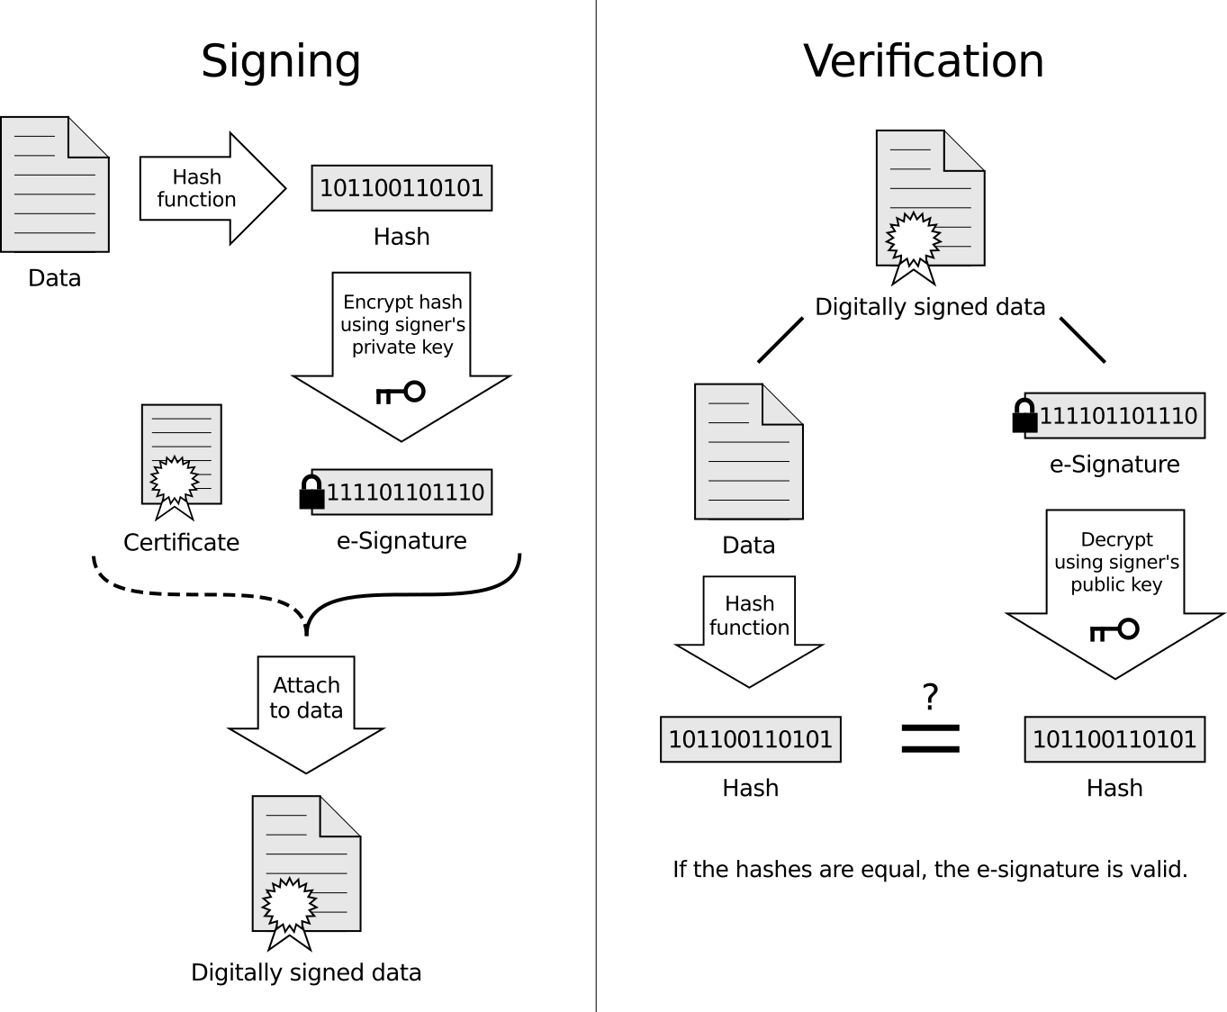
Certificate Authority
Digital Certificates
Digital Signatures / Digital Fingerprints
Digital Certificate of Amit Ukirade
Identity Information and Public Key of Amit
Name : Amit Ukirade
Organization : Parkar Labs
Address : …
Name : Amit Ukirade
Organization : Parkar Labs
Address : …
CA verifies identity of Amit and encrypts with its Private Key
Public Key of Amit Ukirade
Public Key of Amit Ukirade
Digital Signature of CA
Notes:
Also, note I am using technique and algorithm words interchangeably, but there is one difference. Technique is known to everyone, but algorithm may not. Simple example, in cricket ‘Straight Drive’ is technique, every batsman knows this. But when to use it, how to play it is ‘algorithm’. Everyone execute it differently.
Store content securely
Pass content over internet securely
Authentication : To verify the sender’s identity
Non-repudiation : The sender cannot deny having sent the message
Integrity : The message was not altered in transit

Slide 22


FORMATION OF BLOCK
Previous Block (N -1) Signature/Hash
Block N
Block N + 1
Previous Block (N) Signature/Hash
Transaction/ Ledger
Abc
Digital Certificate
10110111
123
Digital Certificate
10000011
Wert
Digital Certificate
10011011
10110101000111011
101010101010111
Block Signature/Hash

Slide 23
BLOCKCHAIN
Key Components
Peer
Consensus
Orderer / Validator
Smart contracts
Notes:
Shared Ledger
Ledger is record keeping file which store the transactions one after another. And Shared ledger is a general agreement of replicated, shared, and synchronized digital data geographically spread across multiple locations. There is no central administrator or centralised data storage. Using a peer-to-peer network ledger replication across nodes is undertaken.
Peers
They are the nodes in the peer-to-peer network, who participate in the network decisions, like broad casting the messages to other peers, approve/reject consensuses. Creating transactions passing them to Orderer, running smart contracts etc.
Miners / Orderer
They are responsible for collecting the transactions, validate them using defined endorsement policies, and rearranging them in block, creating block and broad casting these blocks to other peer nodes.
Consensus
It is general agreement between peers, how to agree upon the new transaction/ ledgers to accepted in system.

Slide 24
BLOCKCHAIN v/s CENTRALIZED DB

Slide 25
WHY THE COMPARISON?
Blockchain
A shared database
supports multiple writers, may or may not trusted completely,
Operates without central authority
Relational DB- robust & proven the test of time
If regular DB exists, then why blockchain?
WHAT WE WILL COVER
Evaluate, why and for what reasons- Blockchain over Databases.

Slide 26
HOW DOES IT CURRENTLY WORK?
Multiple party data exchange
Parties trust intermediary
Parties connect to the central Database the ‘single source of truth’
Key Takeaway: Parties trust the intermediaries to be true to their job
Local database and individual’s version of truth
Difficult to manage and verify information
Time consuming process and settlement
Key Takeaway: No single version of truth, a time consuming settlements, and chances of inaccurate data is quite large
Org 2
Org1
Org 3
Central DB
Org1
Org2
Org3
Local DB
Local DB
Local DB

Slide 27
HOW WILL IT WORK WITH BLOCKCHAIN?
Organizations transacting data in a peer-to-peer network
No intermediary required
A transaction signed by the owner's private key
Ensuring authentication
Consensus of the participating peers
The validators (miners/Orderer’s) responsible for forming blocks based on certain validating algorithm
Real-time transaction monitoring by organization regulators
Ensuring immutably stored
Key Takeaway: The control now lies with the participating organizations rather than one central authority
Validator
Org 1
Org 3
Org2
Peer 1
Peer 3
P2P Transactions
Peer 2

Slide 28
SIMILARITIES BETWEEN BLOCKCHAIN & DB
Key Takeaway
Smart Contracts
Atomicity/Consistency
Robustness
Immutable Append only transactions
Often, we tend to associate some of the concepts associated with blockchain to be proprietary to Blockchain which is not the case, but what are the key differentiators then?

Slide 29
DATABASES ARE MUCH FASTER
Bitcoin takes about 10 minutes to confirm a transaction
The same works faster with permissioned network
With cryptography & consensus in a peer to peer fashion every peer maintains the whole dataset
Blockchain platform is not meant to be the fastest network around

Slide 30
SO THEN, WHY BLOCKCHAIN?
Disintermediation
No central gatekeeper to verify transactions and authenticate its source
Transactions are independently verified and processed by every node maintaining a copy of the database
Questions you need to answer
Does your case need disintermediation?
Does your use case require a platform/technology to share data across trust boundaries wherein the participating members do not need to trust each other nor a central authority?
Do you have an organization/party who can live up to trust to protect not just your data but also others data and ensure tamper proof data?

Slide 31









USE CASE 1
CAR TRADE
Dealer
Consumer
Peer-to-Peer
No Intermediary
Manufacturer
Service Provider
Immutability
Consensus
Insurer
Scrap Market
License Authority

Slide 32









USE CASE 2
HEALTHCARE RECORDS
Physician
IoT devices
Pharmacy
Insurance
Drug Manufacturers
Diagnostic Labs
Hospitals

Slide 33
CONCLUSION
With disparate parties across the world
No governing body that can be completely trusted
Costly affair to maintain a robust & scalable database
Blockchain becomes a definitive use case application for all these use cases

Slide 34
BLOCKCHAIN BUSINESS NETWORK
WHAT CAN BLOCKCHAIN DO?
WHAT IS BLOCKCHAIN CAPABLE OF?
TYPES OF BLOCKCHAIN NETWORK

Slide 35
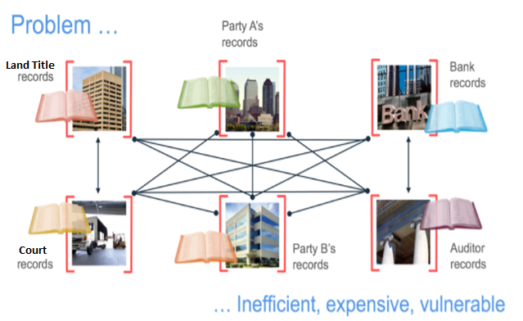
BLOCKCHAIN BUSINESS NETWORK: System of Record (SoR)
Authoritative data source for a given data element
Inefficient: Each participant has
own record
Expensive: Local DB is not
cost-effective
Vulnerable: Records are
susceptible to hacking and
misinformation
Notes:
SoR is authoritative data source for a given data element - Need to identify SoR acute -Multiple orgs may disagree - INTEGRITY and VALIDITY is open to question - Good fit for env where 1. single authority over all consumers 2. All consumers have similar need
Problem Definition: 1. There is no single system with complete data set. 2. Same data with same attributes available in multiple systems
SSoT is trusted data source that gives a complete picture of the data object as a whole - All derived data point to primary SSoT, propagate - Authentic, Relevant and Referable
Today’s SoR: Own separate copy - Assets need to prove provenance, chain of title Issues: 1. Identity 2. Provenance 3. Manual sign 4. SPOF Disadv: 1. Inefficient 2. Expensive 3. Vulneable
Blockchain difference: 1. Std method for identity, 2. Storing data, 3. Execute transaction 4. Provenance proved - Smart Contracts -Adv: 1. Provenance 2. Consensus 3. Immutability

Slide 36
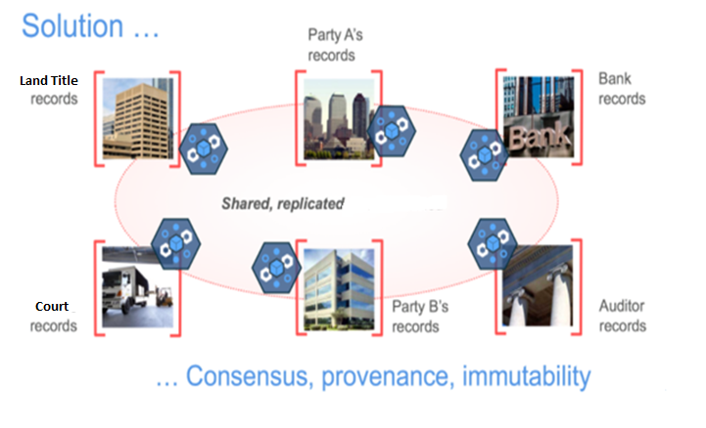
BLOCKCHAIN BUSINESS NETWORK: SINGLE SOURCE OF TRUTH (SSoT)
Trusted data source that gives a complete picture of the data object as a whole.
Provenance: There is single place of origin for all transactions
Consensus: All participants agree on transactions being made
Immutability: Records cannot be changed or removed
Notes:
SSoT is trusted data source that gives a complete picture of the data object as a whole - All derived data point to primary SSoT, propagate - Authentic, Relevant and Referable
Today’s SoR: Own separate copy - Assets need to prove provenance, chain of title Issues: 1. Identity 2. Provenance 3. Manual sign 4. SPOF Disadv: 1. Inefficient 2. Expensive 3. Vulneable
Blockchain difference: 1. Std method for identity, 2. Storing data, 3. Execute transaction 4. Provenance proved - Smart Contracts -Adv: 1. Provenance 2. Consensus 3. Immutability

Slide 37

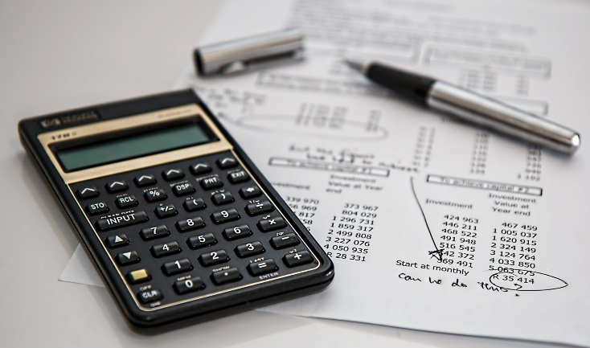




WHAT CAN BLOCKCHAIN DO?
Reduces RISK
Safegaurds business from
tampering, fraud and cybercrime
Saves TIME
Settles transaction time from days to seconds
Reduces COST
Overheads and cost-intermediaries
Removes MIDDLEMAN
Elimination of intermediaries for establishing trust
Establishes TRUST
Increased Trust through shared ledger
CROSS-BORDER transactions
Elimination of government regulations to promote free trade
Notes:
1. Saves TIME: Settles transaction time from days to seconds
2. Reduces cost: Overheads and cost-intermediaries
3. Reduces RISK: Safegaurds business from tampering, fraud and cybercrime
4. Removes MIDDLEMAN: Elimination of intermediaries for establishing trust
5. CROSS-BORDER transactions: Elimination of government regulations to promote free trade
6. Establishes TRUST: Increased Trust through shared ledger

Slide 38


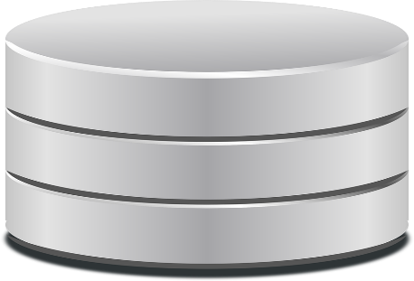
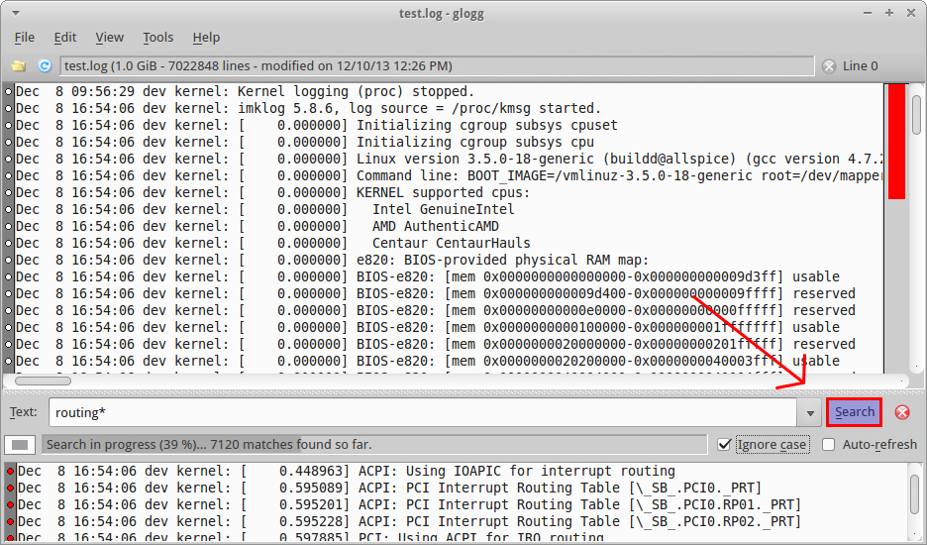


WHAT IS BLOCKCHAIN CAPABLE OF?
Establish Digital Identity
Serve as Single Source of Truth
Public Key
(Bank Account Number)
Private Key
(Bank Authorization Password)
Shared ledger stored across all the nodes on the network
Prove Immutable
Serve as Platform
Maintains history of itself
Platform for cryptocurrency
Platform for smart contracts
Notes:
- 1. Establish Digital Identity: IoT - By year 2020, 50 billion devices - No man-in-the-middle-attack
2. Serve as SSoT - Blockchain will eliminate issue with multiple parties claiming - Blockchain by design stores
3. Blockchain by design maintains truth in 2 sources 1. world state 2. transaction log
4. Blockchain serve as platform for 2 kinds of business: 1. Platform for currency 2. Platform for Smart Contracts

Slide 39
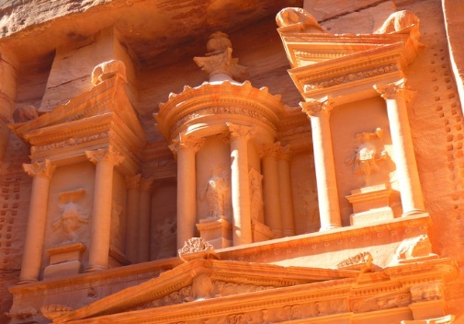



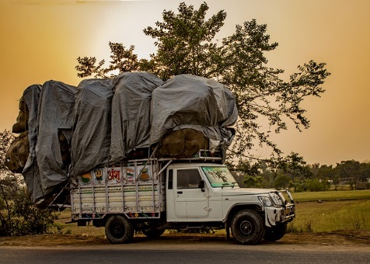

TYPES OF BLOCKCHAIN NETWORK
Public Ledger:
[Anyone can join, all permissions,
exposes all transactions]
Private Ledger:
[decentralized, distributed,
highly secure, immutable,
transparent and permissioned]
Hybrid Ledger: [Combination]
+
Notes:
Public (or “permissionless”) ledgers :
Anyone can join the network, Receive identical permissions BUT
Visible to all network participants the identity of the transacting parties is never revealed
exposes all transaction data to an enormous network, also conflicts with their data privacy and confidentiality obligations
2. Private ledgers (eg. transactions involving financial institutions – trade finance, remittances, syndicated lending, treasury operations etc. – need certain controls)
decentralized, distributed, highly secure, immutable, and transparent.
view, modify and authorize transactions privileges are permissioned
3. Hybrid ledger: (eg. goods retailer, who also has bitcoin dealings) - Monetary exchanges through cryptocurrency + Goods movement, vendor network, pricing, warehouse locations

Slide 40

OPEN MIC

Slide 41

Thank you for coming!

Slide 42

Product Lifecycle Management
Customization & Integrations Rapid Prototyping
User Experience
Data Strategy &Architecture
Data Models &Integration
Design & Development
Visualization
Marketing Automation
Advanced Analytics
Social & Mobile
Connected
Security & Cloud Computing
Infrastructure as a Service
Platform as a Service
Tools Automation
Software Development
Data Services
Digital
Infrastructure Convergence
www.parkar.consulting
info@parkar.consulting
+1 844 8246 686
(C) Parkar Consulting LLC 2017 Confidential & Proprietary

